Slide 1
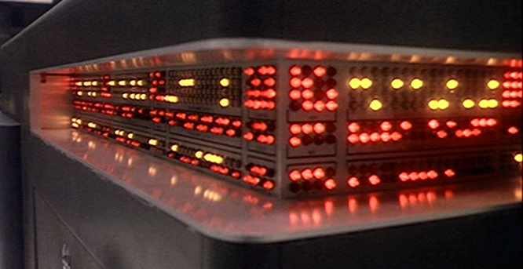
Natural Language Processing
COMP 4230
David J Stucki
Fall 2021

Slide 2
ALERTS
Read Moroney Chapter 6
Read Larson Chapter 11

Slide 3
The concept of dialect
Dialects used by different speech communities
Language

Slide 4
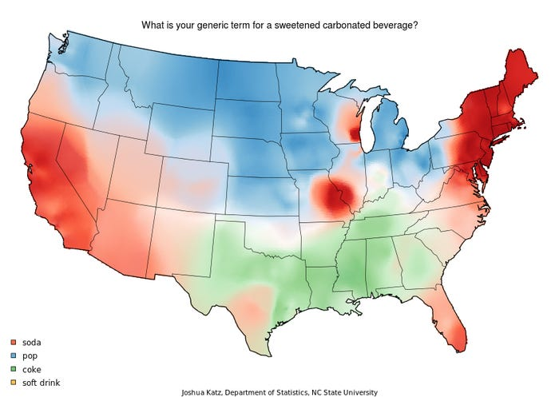

Slide 5
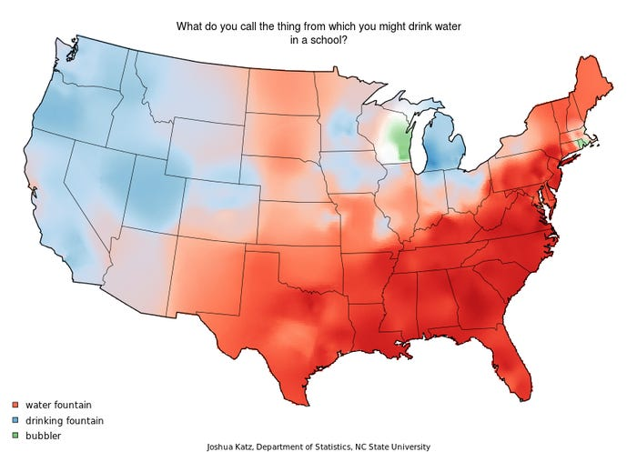

Slide 6
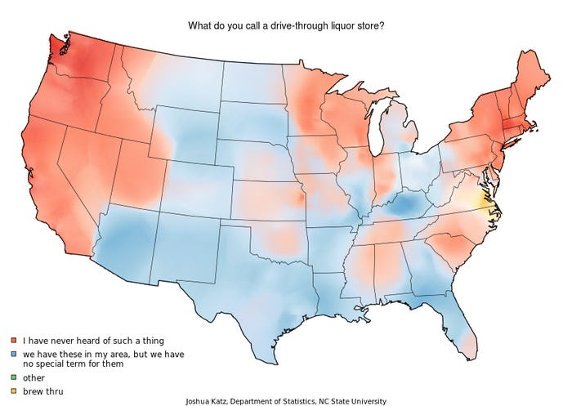

Slide 7
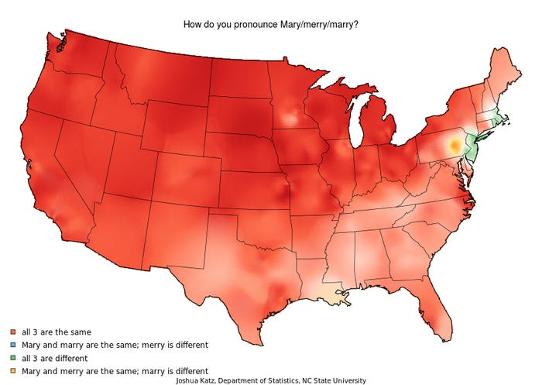

Slide 8
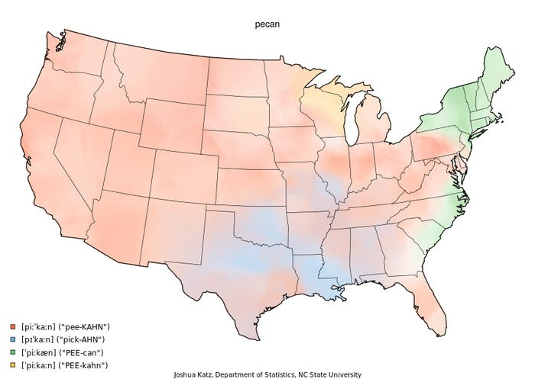
http://dialect.redlog.net/

Slide 9
Basic Text Processing
Regular Expressions
What are they?
What are they good for?
Word Tokenization
What does this mean?
How do we do it?
Word Normalization
Any idea here?

Slide 10
RegEx Example
Find me all instances of the word “the” in a text.
the
Misses capitalized examples
[tT]he
Incorrectly returns other or theology
[^a-zA-Z][tT]he[^a-zA-Z]

Slide 11
RegEx Errors
The process we just went through was based on fixing two kinds of errors
Matching strings that we should not have matched (there, then, other)
False positives (Type I)
Not matching things that we should have matched (The)
False negatives (Type II)

Slide 12
RegEx Errors
In NLP we are always dealing with these kinds of errors.
Reducing the error rate for an application often involves two antagonistic efforts:
Increasing accuracy or precision (minimizing false positives)
Increasing coverage or recall (minimizing false negatives).

Slide 13
RegEx Summary
Regular expressions play a surprisingly large role
Sophisticated sequences of regular expressions are often the first model for any text processing approach
For many hard tasks, we use machine learning classifiers
But regular expressions are used as features in the classifiers
Can be very useful in capturing generalizations

Slide 14
Text Normalization
Every NLP task needs to do text normalization:
Segmenting/tokenizing words in running text
Normalizing word formats
Segmenting sentences in running text

Slide 15
How many words?
they lay back on the San Francisco grass and looked at the stars and their
Type: an element of the vocabulary.
Token: an instance of that type in running text.
How many?
15 tokens (or 14)
13 types (or 12) (or 11?)

Slide 16
How many words?
N = number of tokens
V = vocabulary = set of types
|V| is the size of the vocabulary
Church and Gale (1990): |V| > O(N^{½})
 | Tokens = N | Types = |V|
Switchboard phone conversations | 2.4 million | 20 thousand
Shakespeare | 884,000 | 31 thousand
Google N-grams | 1 trillion | 13 million

Slide 17
Issues in Tokenization
Finland’s capital → Finland Finlands Finland’s ?
what’re, I’m, isn’t → What are, I am, is not
Hewlett-Packard → Hewlett Packard ?
state-of-the-art → state of the art ?
Lowercase → lower-case lowercase lower case ?
San Francisco → one token or two?
m.p.h., PhD. → ??

Slide 18
Tokenization: language issues
French
L'ensemble → one token or two?
L ? L’ ? Le ?
Want l’ensemble to match with un ensemble
German noun compounds are not segmented
Lebensversicherungsgesellschaftsangestellter
‘life insurance company employee’
German information retrieval needs compound splitter

Slide 19
Tokenization: language issues
Chinese and Japanese no spaces between words:
Sharapova now lives in US southeastern Florida
Further complicated in Japanese, with multiple alphabets intermingled
Dates/amounts in multiple formats
Katakana
Hiragana
Kanji
Romaji
End-user can express query entirely in hiragana!

Slide 20
Natural Language Processing in TensorFlow

Slide 21
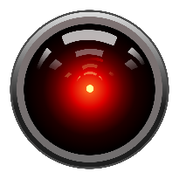
Tokenizing in Tensorflow
import tensorflow as tf from tensorflow import keras from tensorflow.keras.preprocessing.text import Tokenizer sentences = [ 'Today is a sunny day', 'Today is a rainy day' ] tokenizer = Tokenizer(num_words = 100) tokenizer.fit_on_texts(sentences) word_index = tokenizer.word_index print(word_index)
'sentences' is the corpus of data we are processing
'num_words' is an upper bound on the number of unique words
'word_index' is a dictionary that associates each word with a number, or index
{'today': 1, 'is': 2, 'a': 3, 'day': 4, 'sunny': 5, 'rainy': 6}

Slide 22
Sentence→Sequence in Tensorflow
sentences = [ 'Today is a sunny day', 'Today is a rainy day', 'Is it sunny today?' ] tokenizer = Tokenizer(num_words = 100) tokenizer.fit_on_texts(sentences) word_index = tokenizer.word_index
print(word_index)
sequences = tokenizer.texts_to_sequences(sentences) print(sequences)
The tokenizer has filters that deal with case, punctuation, etc.
'texts_to_sequences' will apply the word_index to a given text
{'today': 1, 'is': 2, 'a': 3, 'sunny': 4, day': 5, 'rainy': 6, 'it': 7}
[[1, 2, 3, 4, 5], [1, 2, 3, 6, 5], [2, 7, 4, 1]]

Slide 23
Vocabulary Issues
What happens when a word appears in some test data that never occurred in the training data?
The encoding of the sentence will simply skip that word, likely making the resulting sentence ungrammatical (and non-sensical)
tokenizer = Tokenizer(num_words = 100, oov_token = "<OOV>") test_data = ['Today is a snowy day', Will it be rainy tomorrow'] test_seq = tokenizer.texts_to_sequences(test_data) print(word_index) print(test_seq)
{'<OOV>': 1, 'today': 2, 'is': 3, 'a': 4, 'sunny': 5, day': 6, 'rainy': 7, 'it': 8}
[[2, 3, 4, 1, 6], [1, 8, 1, 7, 1]]

Slide 24
Padding
Not all sentences have the same number of words
Neural network architectures are happiest when the input has a consistent shape
So we will use padding to make all the sentence vectors the same length
Padding can be added at the left (default) or the right
Padding can match the longest length (default), or truncate to some smaller length

Slide 25
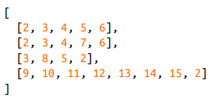
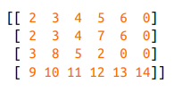
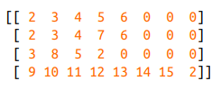
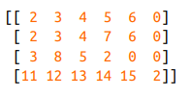
Padding
from tensorflow.keras.preprocessing.sequence import pad_sequences
leftpad = pad_sequences(sequences)
rightpad = pad_sequences(sequences, padding = 'post')
rightpad6 = pad_sequences(sequences, padding = 'post', maxlen = 6)
rightpad6p = pad_sequences(sequences, padding = 'post', maxlen = 6, truncating = 'post')

Slide 26
Data Scrubbing
Not all words are useful in a text processing application
It is easy to maintain a list of stopwords that should be removed before normalization
There is often punctuation or other notations that should be removed as well (such as HTML tags)
A library package called BeautifulSoup can handle HTML
Punctuation can be handled by standard string library functions

Slide 27
Data Sources
Chapter 5 discusses getting data from a variety of sources
TFDS (TensorFlow Data Sets)
JSON files
CSV files

Slide 28
Next Time...
Sentiment Analysis (Chapter 6)

